Slide 1
A sample data analysis
Presented by: Ramesh Baral
Monday, April 17, 2017

Slide 2
DATA ANALYSIS

Slide 3
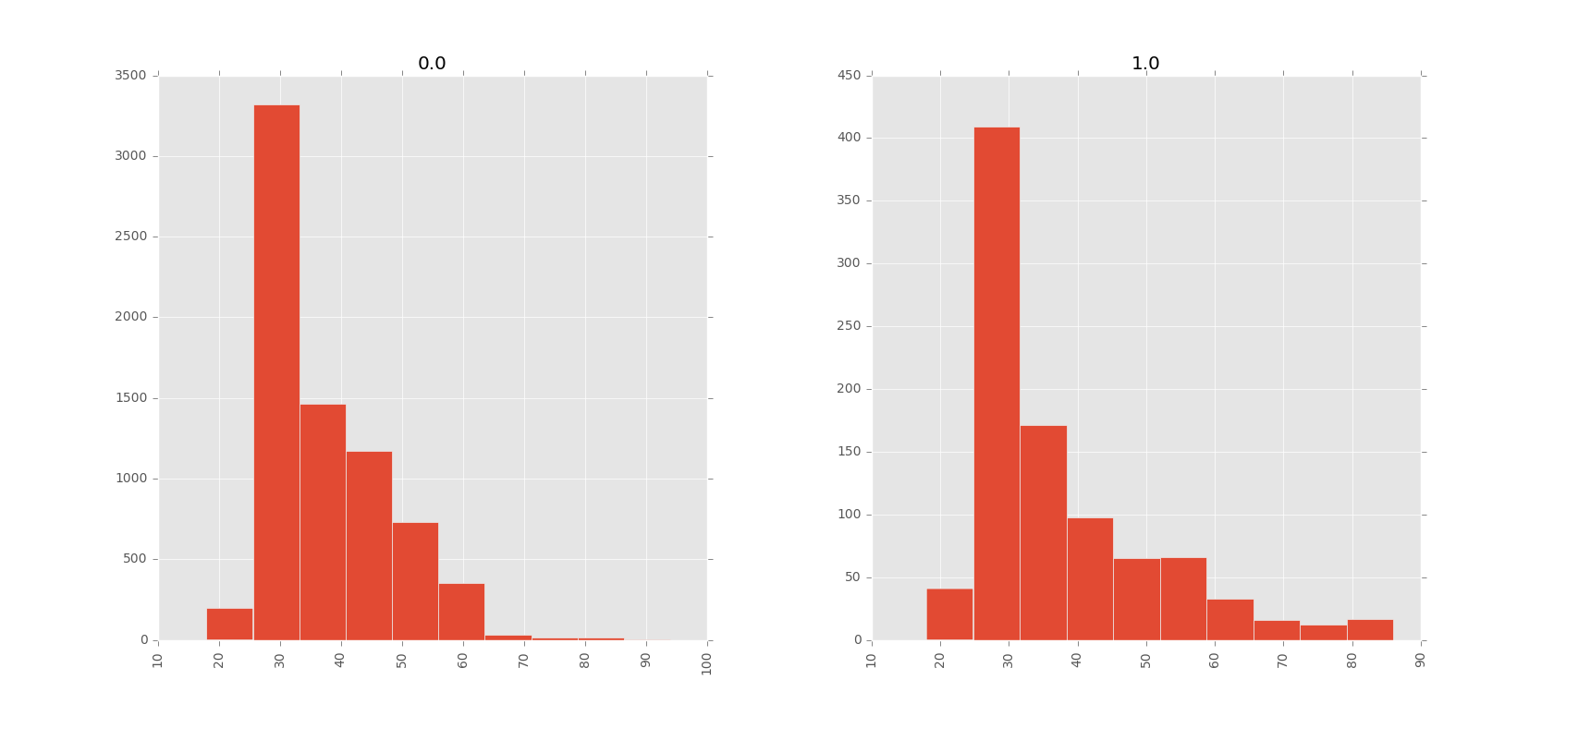
Age distribution
Fig: Age- response distribution (left chart for response = 0, right for response = 1)

Slide 4
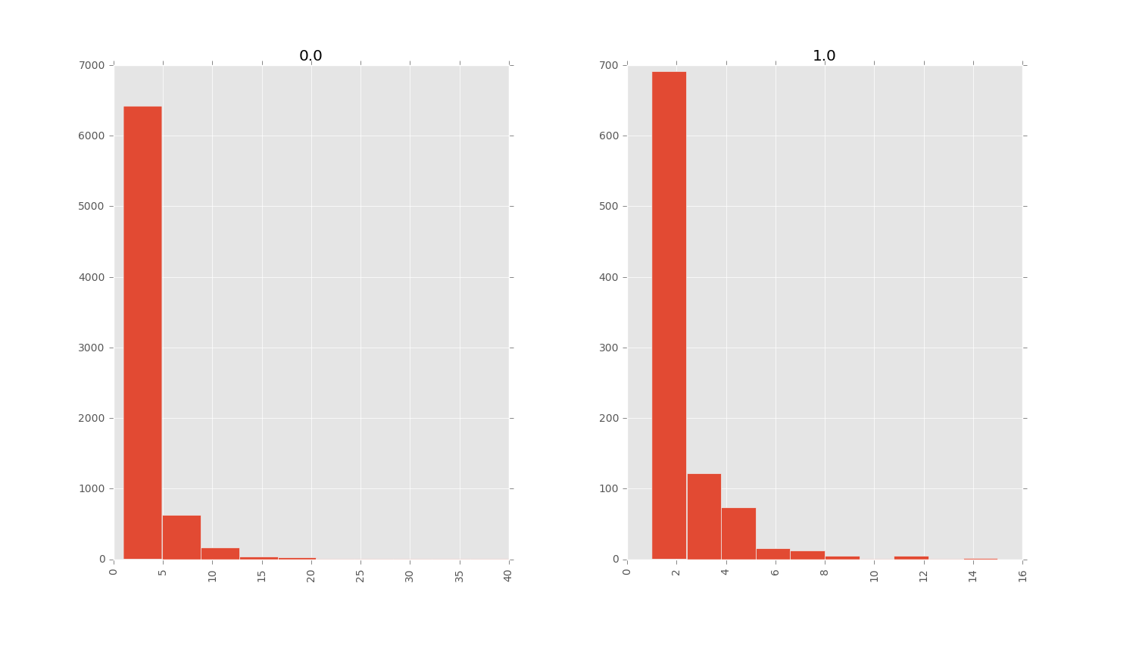
Campaign distribution
Fig: Campaign- response distribution (left chart for response = 0, right for response = 1)

Slide 5
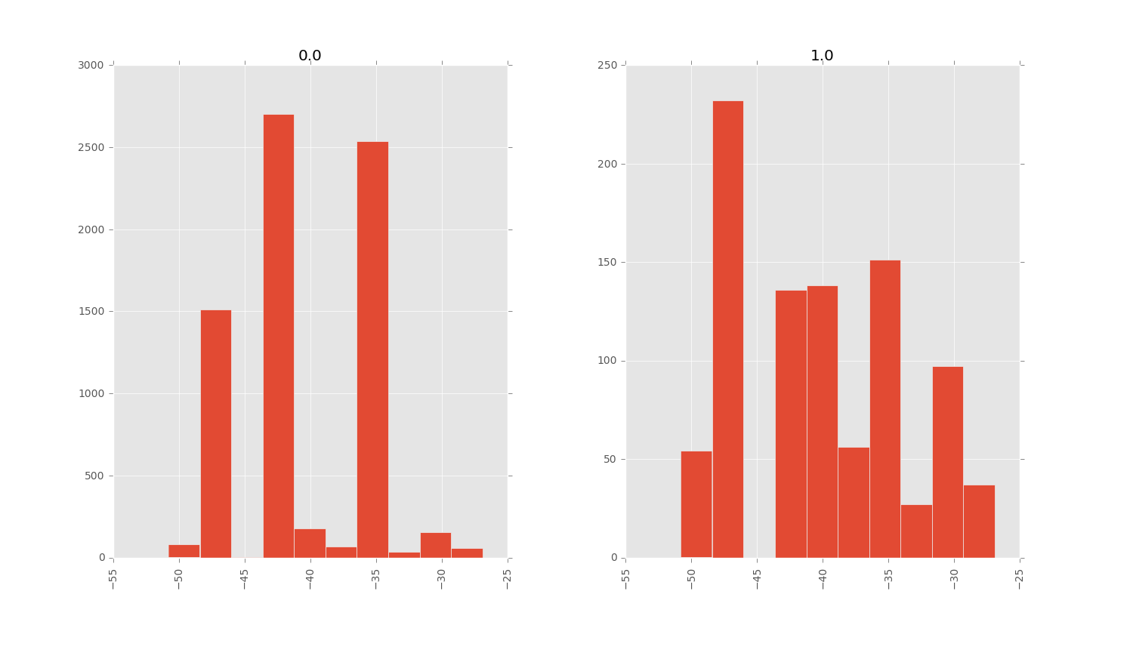
Consconf distribution
Fig: Consconf- response distribution (left chart for response = 0, right for response = 1)

Slide 6
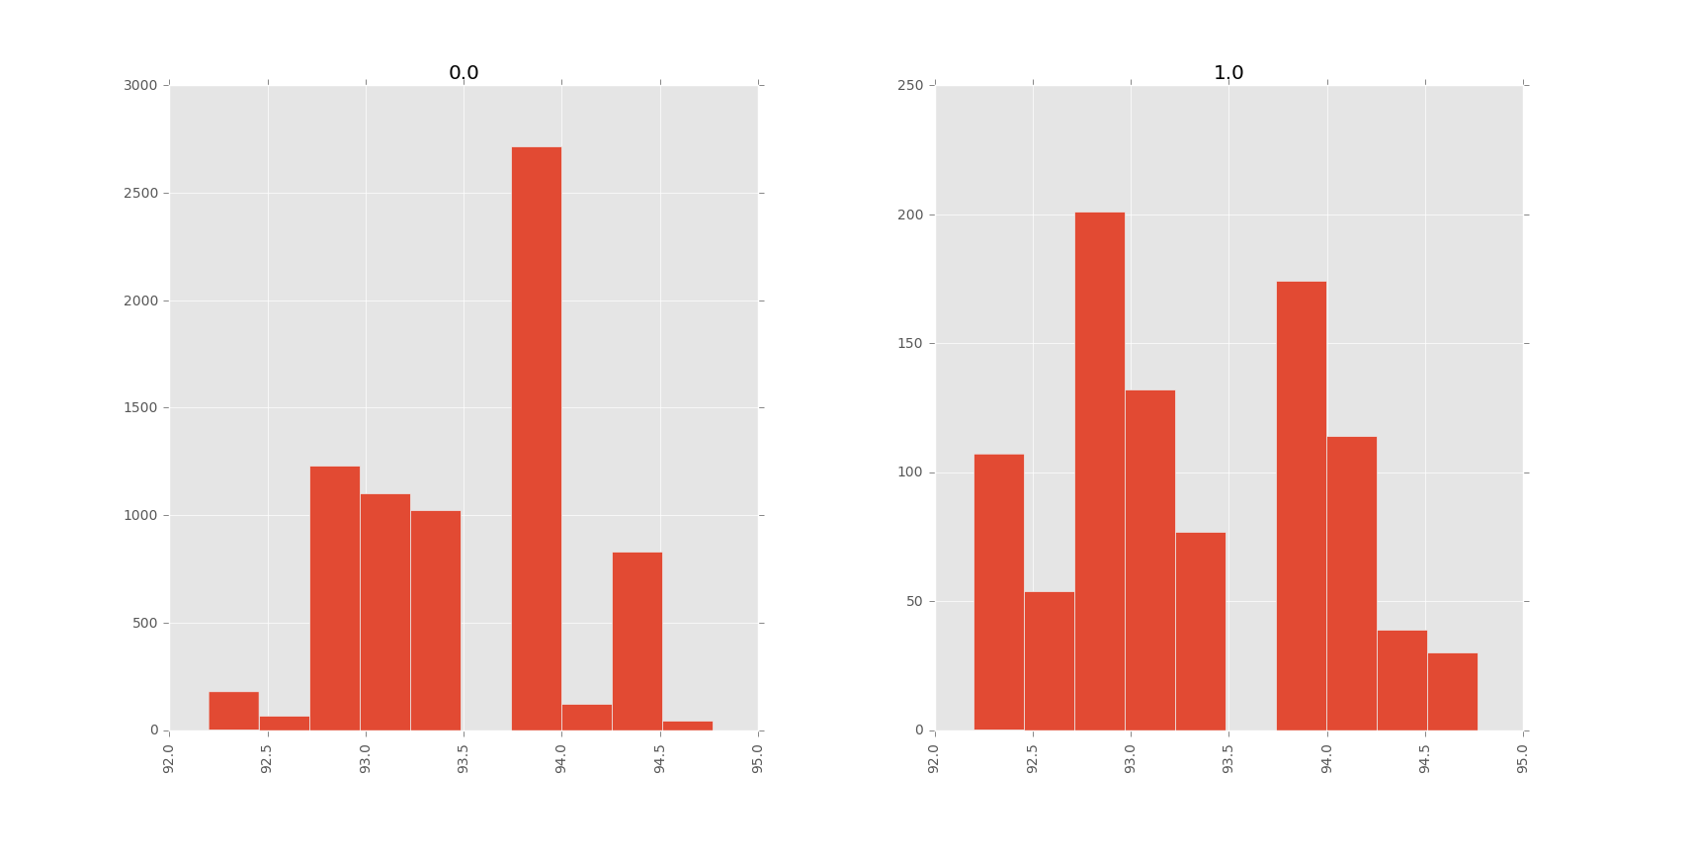
Consprice distribution
Fig: Consprice- response distribution (left chart for response = 0, right for response = 1)

Slide 7
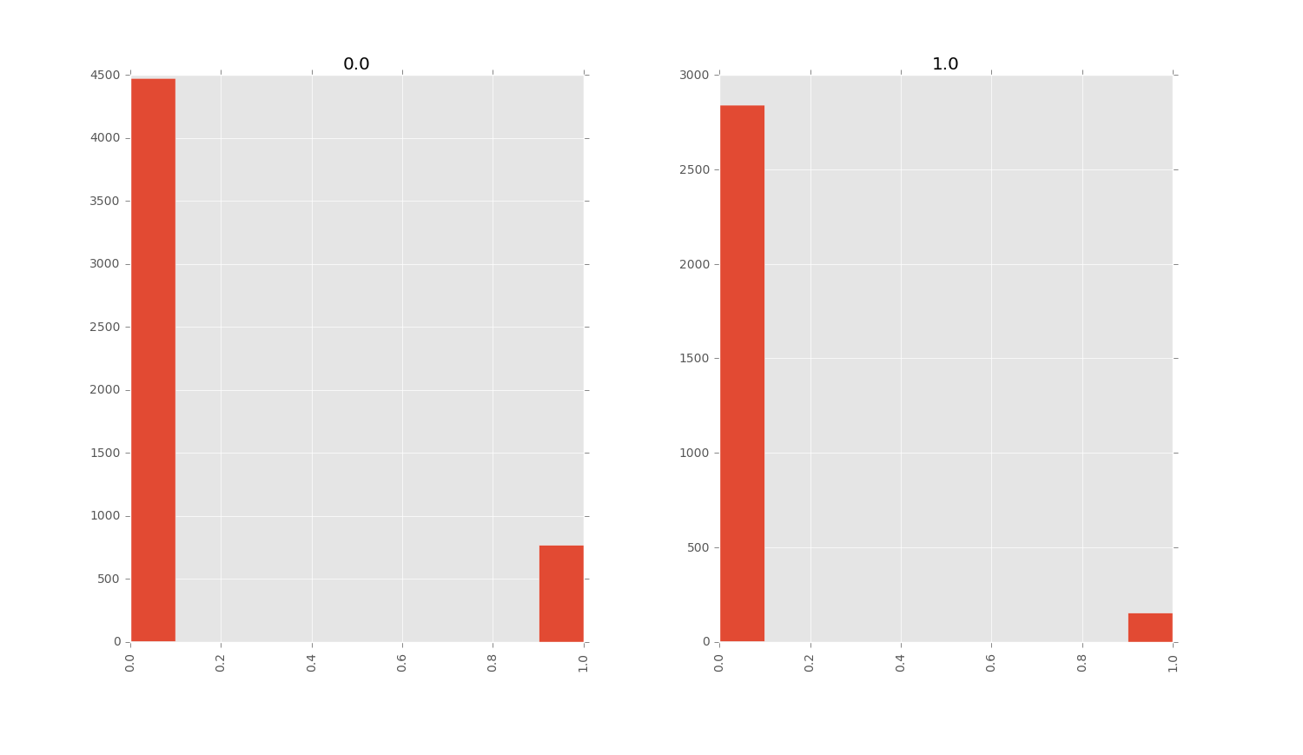
Contact distribution
Fig: Contact- response distribution (left chart for response = 0, right for response = 1)

Slide 8
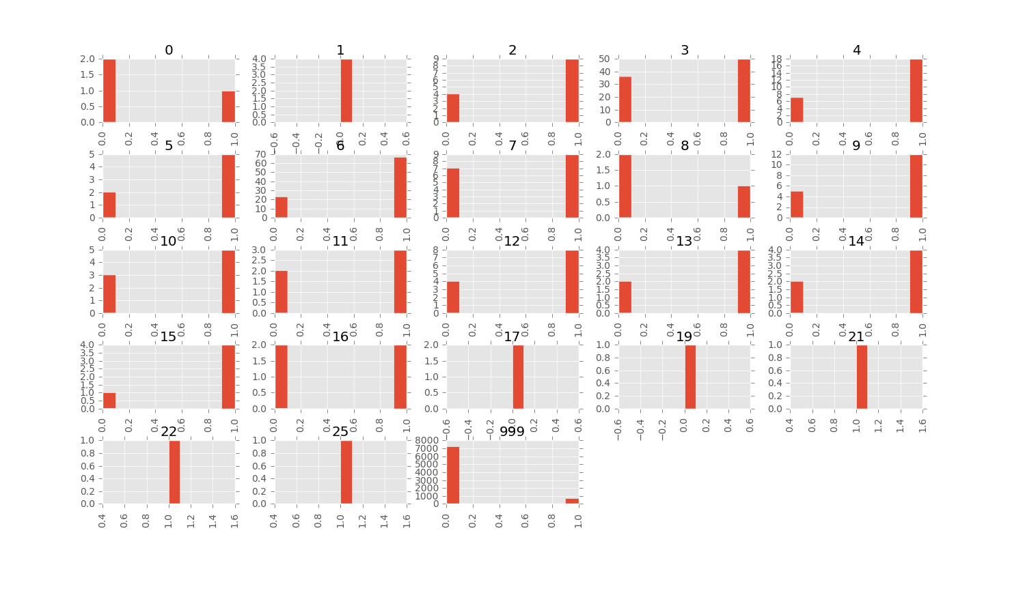
Days distribution
Fig: Days- response distribution (small charts X-axis = pdays count, Y-axis = response)

Slide 9
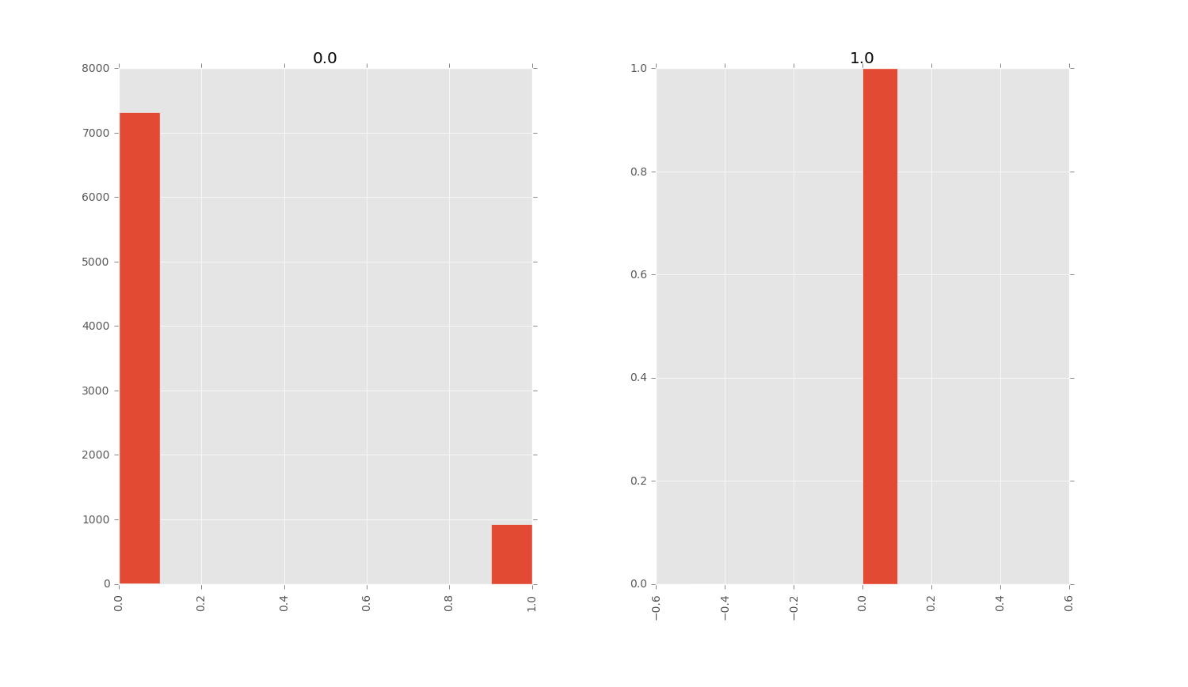
Default distribution
Fig: Default- response distribution (left chart for response = 0, right for response = 1)

Slide 10
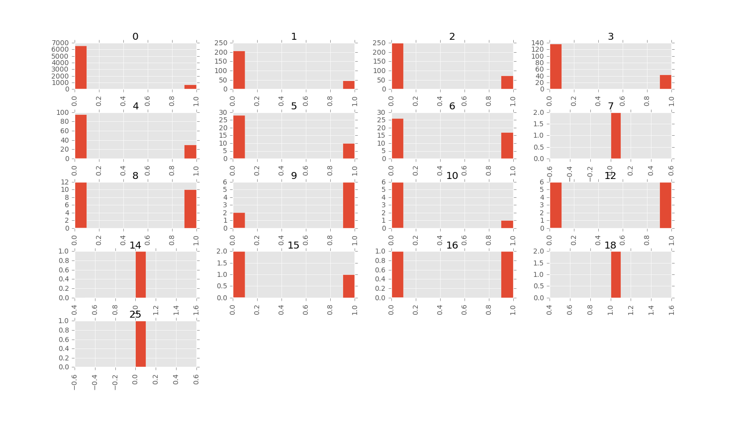
Pastemail distribution
Fig: Pastemail- response distribution (small charts X-axis = pastemail count, Y-axis = response)

Slide 11
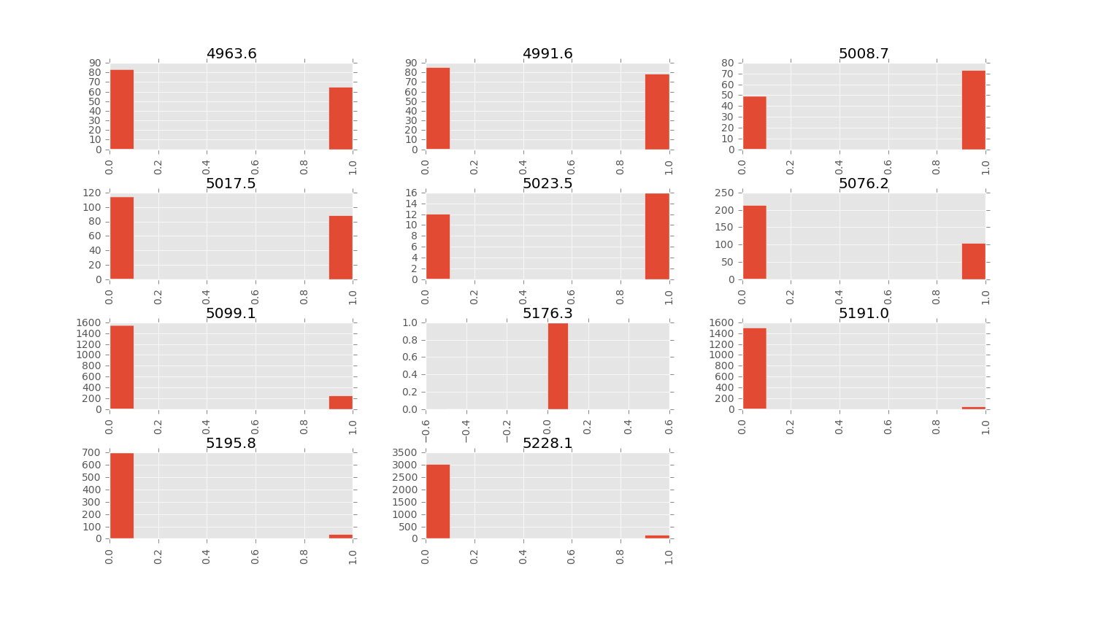
Nr.employed distribution
Fig: Nr.employed- response distribution (small charts X-axis = nr.employed count,
Y-axis = response)

Slide 12
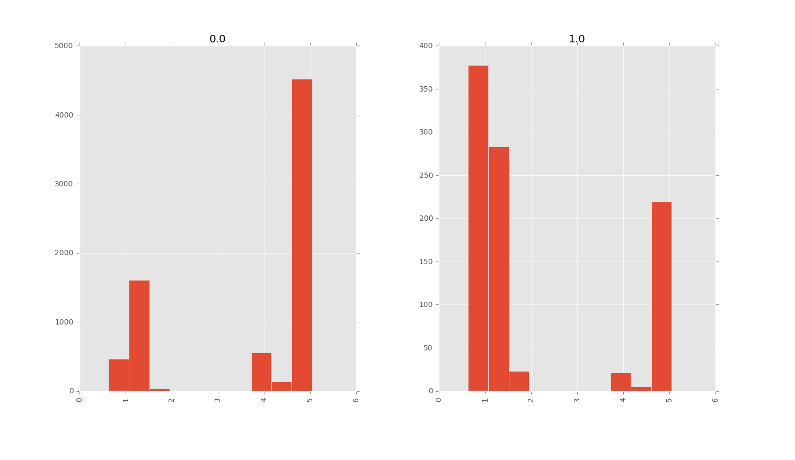
Euribor3m distribution
Fig: Euribor3m- response distribution (left chart for response = 0, right for response = 1)

Slide 13
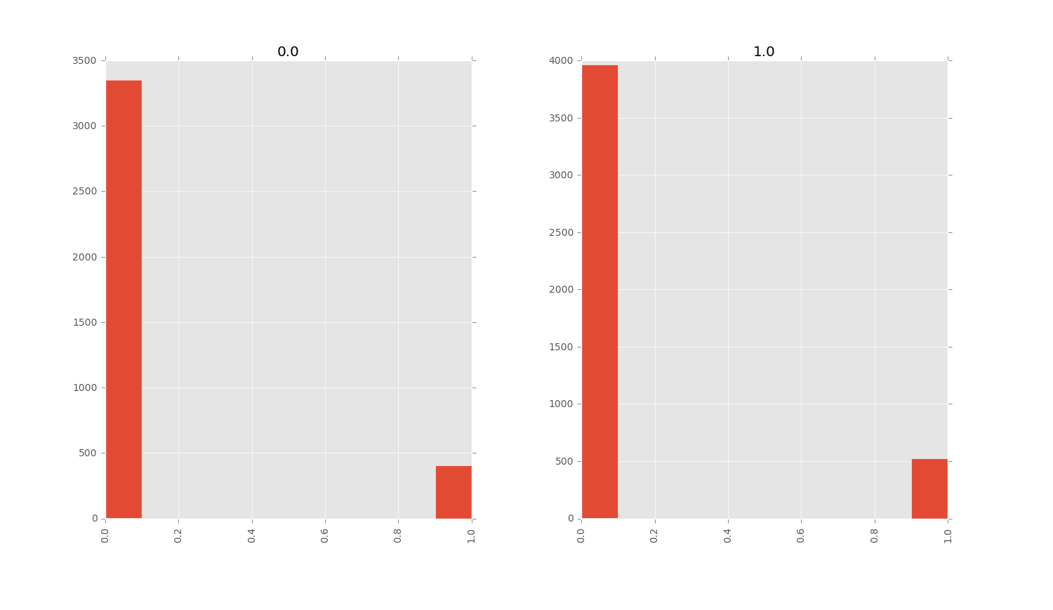
Housing distribution
Fig: Housing- response distribution (left chart for response = 0, right for response = 1)

Slide 14
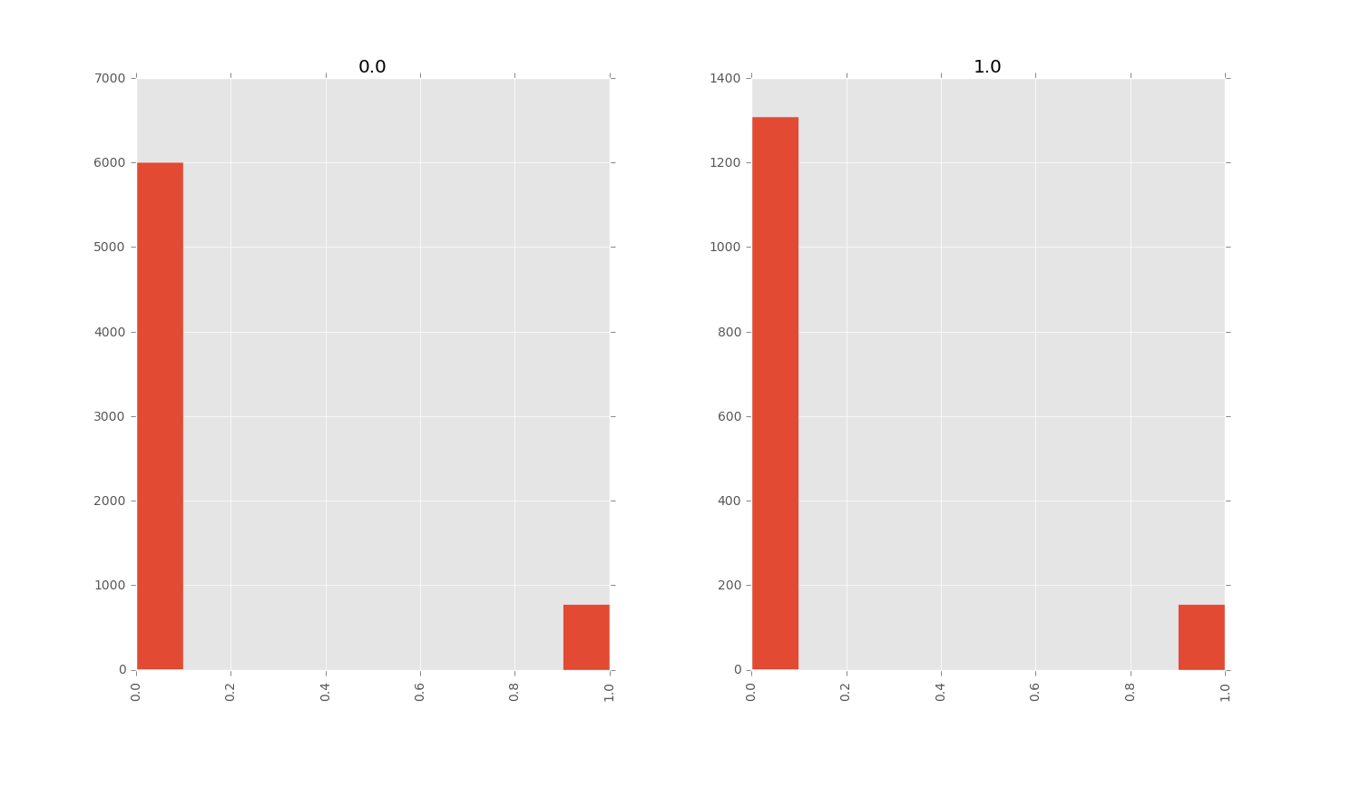
Loan distribution
Fig: Loan- response distribution (left chart for response = 0, right for response = 1)

Slide 15
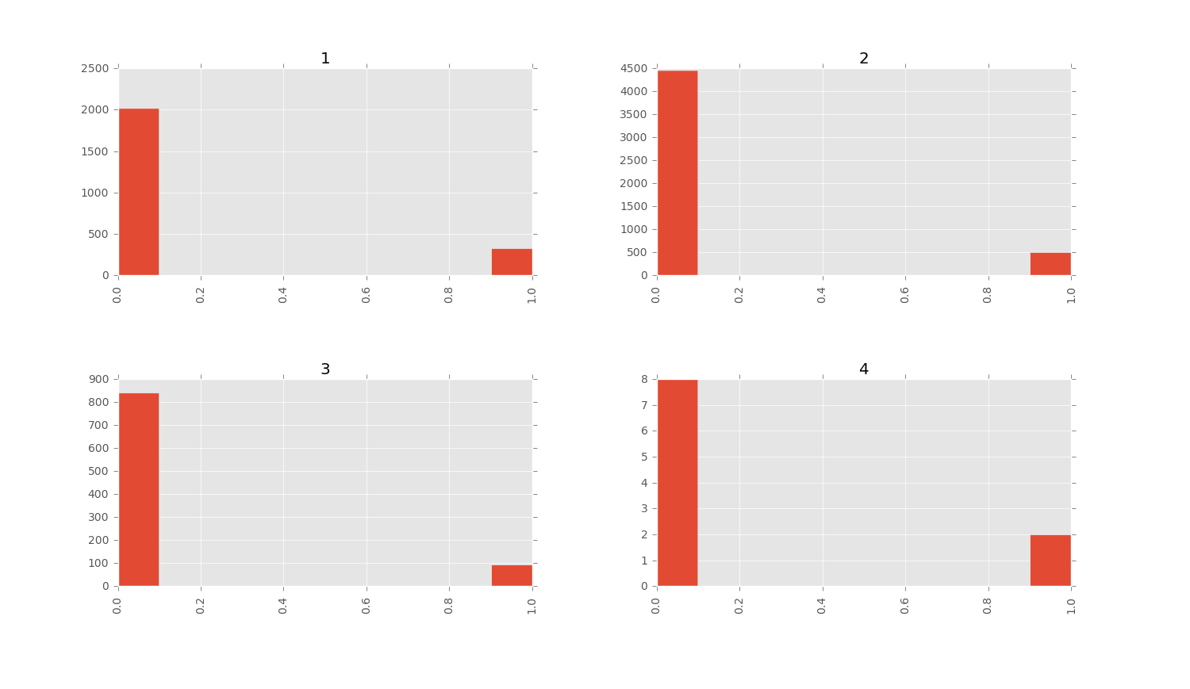
Marital distribution
Fig: Marital- response distribution (small charts X-axis = marital count,
Y-axis = response; marital: single=1, married =2, divorced=3, others =4)

Slide 16
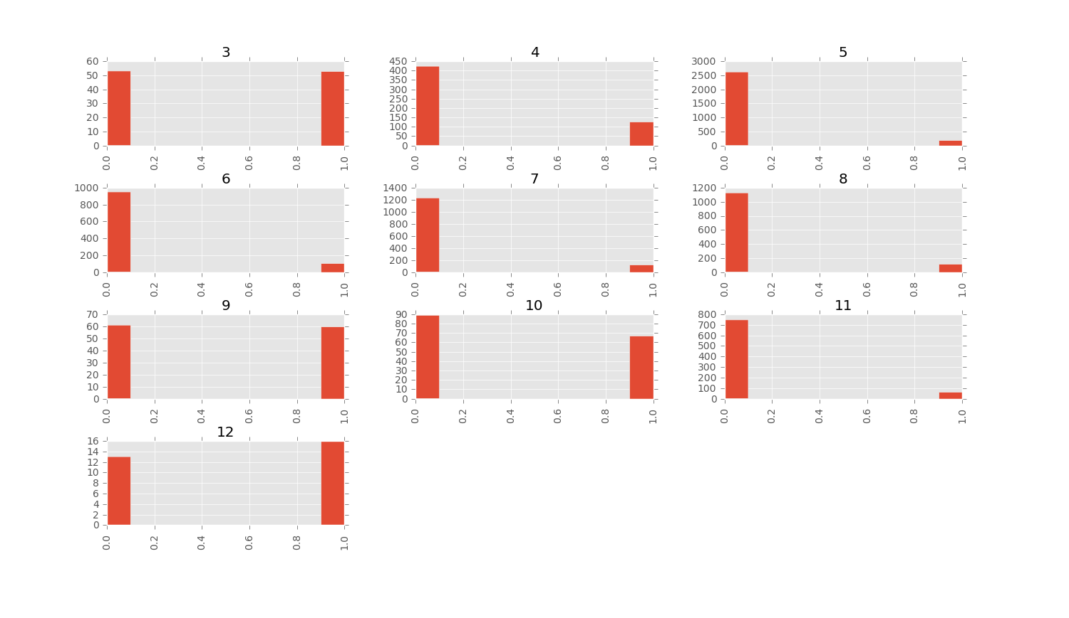
Pmonth distribution
Fig: Pmonth- response distribution (small charts X-axis = pmonths count,
Y-axis = response; months: Jan=1, Feb =2, and so on)

Slide 17
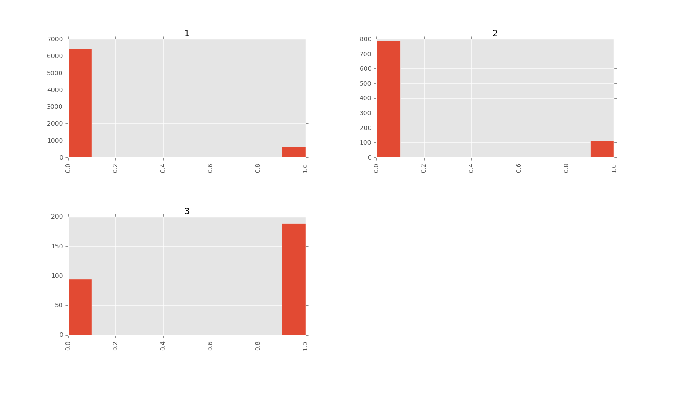
Poutcome distribution
Fig: Poutcome- response distribution (small charts X-axis = poutcome count,
Y-axis = response; poutcome: nonexistent =1, failure =2, others =3)

Slide 18
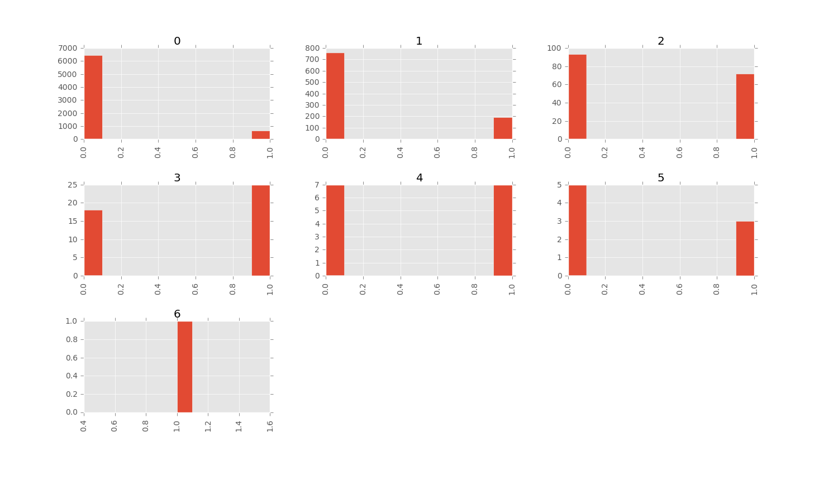
Previous response distribution
Fig: Prev response- response distribution (small charts X-axis = prevresponse count,
Y-axis = response; poutcome: nonexistent =1, failure =2, others =3)

Slide 19
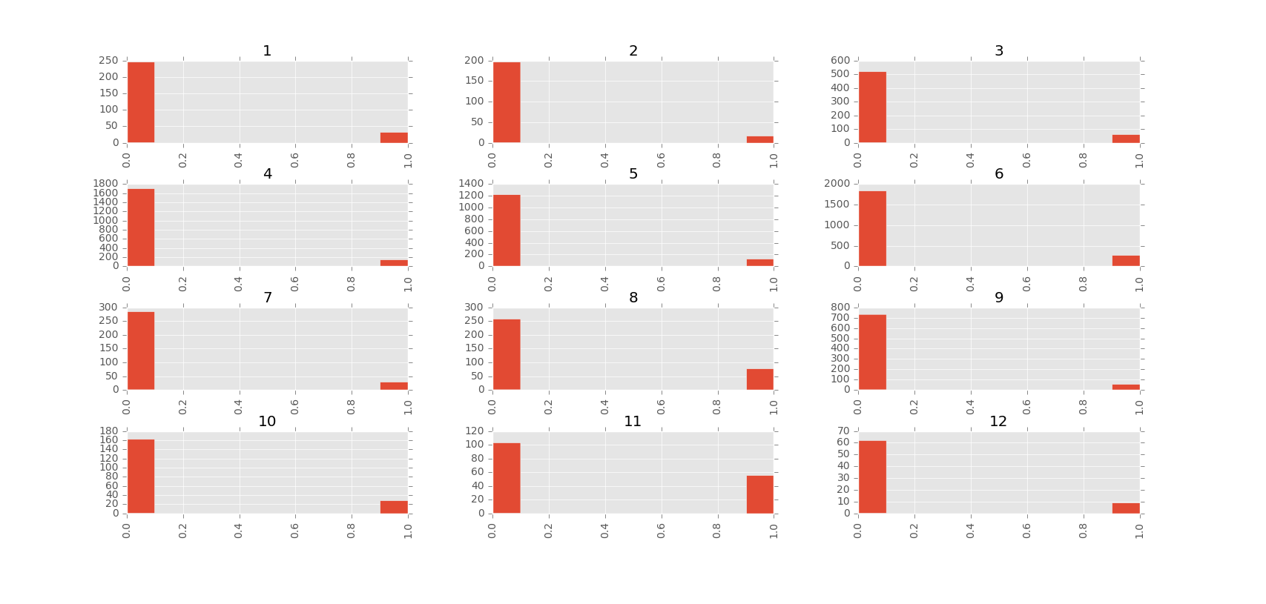
Profession distribution
Fig: Profession- response distribution (small charts X-axis = profession count,
Y-axis = response; profession: self-employed =1, housemaid =2, management =3, blue-collar =4,
etc.)

Slide 20
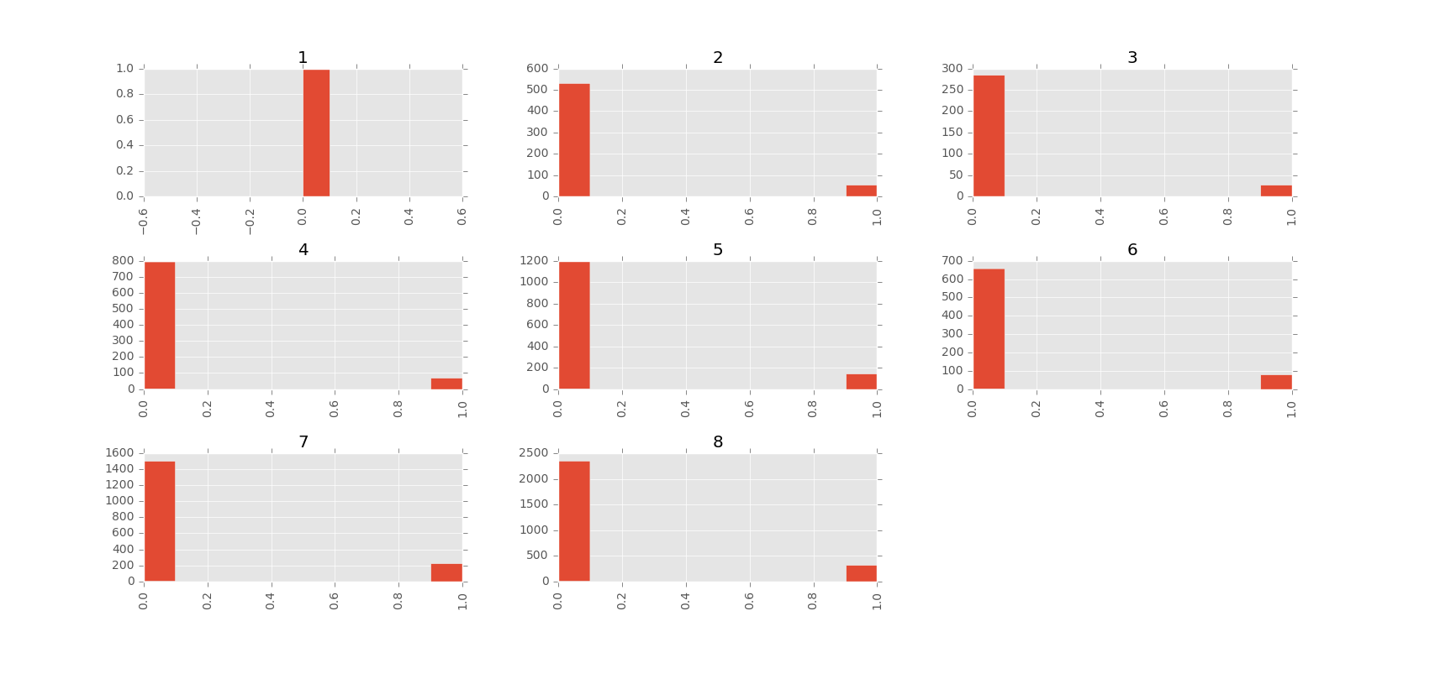
Schooling distribution
Fig: Schooling- response distribution (small charts X-axis = schooling count,
Y-axis = response; schooling: illiterate=1, basic.4 =2, basic.6 =3, basic.9 =4, highschool=5,
professionalcourse=6,universitydegree=7, others=8)

Slide 21
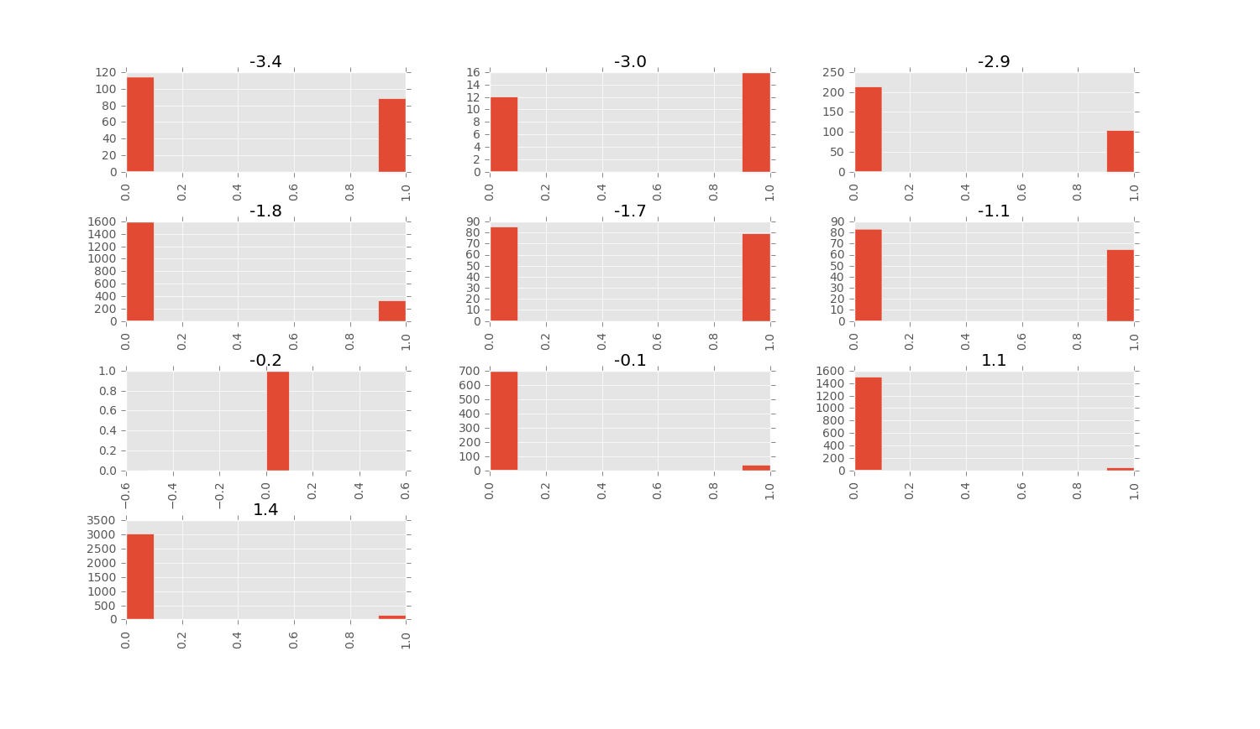
Varrate distribution
Fig: Emp.var.rate- response distribution (small charts X-axis = emp.var.rate count,
Y-axis = response)

Slide 22
Data Preprocessing
From the observation and data analysis, we filter out some of the fields that seem to have minimal or no effect on target variable
Missing values are replaced by mean or the the dominating value for that column
All string values are converted into numeric (for e.g., for months, 1 for Jan, 2 for Feb and so on), this is required to operate the machine learning algorithms

Slide 23
Models used
SVM
RandomForest
Knearest Neighbors
Gradient Descent
Logistic Regression
Gaussian NaïveBayes

Slide 24
Model training
All the models were trained using a portion (85%) of training data
15% of the training data was used as validation set to select the best model
The test data was used for prediction by the best model

Slide 25
Tools and platform used
Python – the programming language
Numpy – the mathematical and numeric computation library
Pandas – the data manipulation library
Sklearn – the Machine Learning algorithm package
Matplotlib – the visualization package
PyCharm – the editor

Slide 26
Performance with all fields
MODELS | Accuracy
SVM | 0.8988
RandomForest | 0.9069
KNN | 0.8915
LOGISTIC REGRESSION | 0.9101
GRADIENT DESCENT | 0.9077
Naïve Bayes | 0.8228

Slide 27
Field selection
From observation of the distribution of fields and the target field, following fields were found more relevant:
‘custAge', 'profession', 'marital‘, 'schooling', 'default','pdays','previous', 'emp.var.rate‘, 'cons.price.idx‘, 'cons.conf.idx', 'euribor3m','pmonths','loan', 'contact', 'month','day_of_week
However, the performance of the model didn’t vary that much even just considering these fields

Slide 28
Performance with selected fields
MODELS | Accuracy
SVM | 0.9021
RandomForest | 0.8932
KNN | 0.8964
LOGISTIC REGRESSION | 0.9093
GRADIENT DESCENT | 0.9077
Naïve Bayes | 0.8762

Slide 29
Potential enhancements
Detail analysis of the fields
Use feature embedding (Word2Vec, Glove, etc.)
Use combination of features

Slide 30
Source codes
DataLoader.py – contains methods to read the data files (in csv format)
Util.py – a utility class, contains some static fields and methods
DataModel.py – the main file that contains the data analysis, preprocessing, prediction feature
How to run:
Update the file path to train and test data in Util.py
Run from command line: python -m com.uptake.DataModel

